Slide 1
Multiple Linear Regression (I)

Slide 2
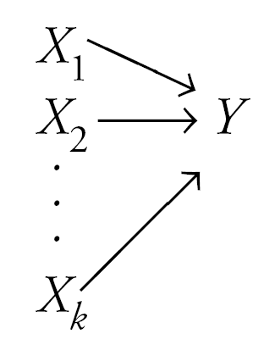
Multiple Linear Regression
Statistical method for studying the relationship between a dependent variable and two or more independent variables. Multiple regression simultaneously considers the influence of multiple independent variables on a dependent variable Y.
Purposes:
  Prediction
  Explanation
  Theory building

Slide 3
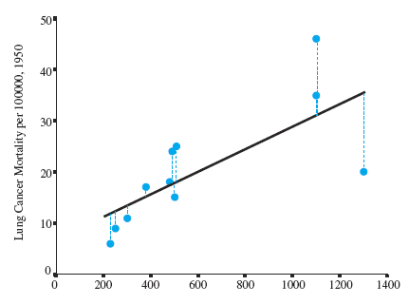
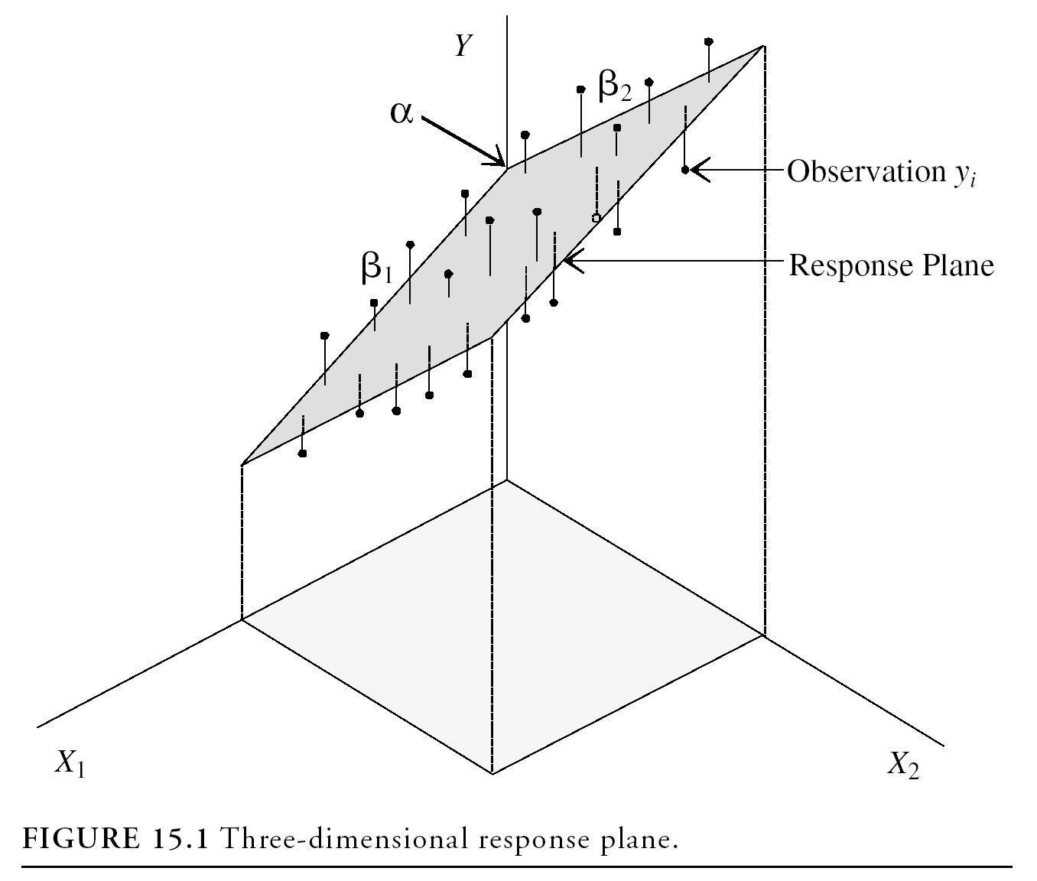
Regression Modeling
A simple regression model (one independent variable) fits a regression line in 2-dimensional space
A multiple regression model with two explanatory variables fits a regression plane in 3-dimensional space

Slide 4

Multiple Regression Modeling
A multiple regression model with k independent variables fits a regression “surface” in k + 1 dimensional space (cannot be visualized)

Slide 5
Real life applications
Economy:
GDP growth can be determined by factors such as natural resources, technology, human capital, investment, inflation rate, etc.
Insurance:
Car accident rate can be predicted by weather conditions, day of the week, number of broken traffic lights, number of cars on the road, etc.
Technology:
Computer-based assessment system (CbAS), which can grade essays based on text length, errors in vocabulary, sentence structure, lexical complexity, etc.

Slide 6
The General Multiple Linear Model
y – dependent (response, outcome) variable.
x₁, x₂, …, x_{k} - independent (predictor, explanatory) variables.
β₀ – intercept.
β₁, β₂, …, β_{k} – partial slopes or partial regression coefficients.
ε – error terms.

Slide 7
Estimated (fitted) Multiple Regression Model
^
y = b₀ + b₁x₁ + b₂x₂ + . . . + b_{k}x_{k}
Least squares method is used to compute sample statistics b₀, b₁, b₂, . . . , b_{k} that are used as the point estimators of the parameters β₀, β₁, β₂, . . . , β_{k}.

Slide 8
Least Squares Method
Least Squares Criterion
Computation of Coefficient Values
The formulas for the regression coefficients
b₀, b₁, b₂, . . . b_{k} involve the use of matrix algebra.
We will rely on computer software packages to
perform the calculations.

Slide 9
Assumptions of Multiple Linear Regression (How to diagnose)
Normality: Multiple regression assumes that the error terms are normally distributed (Normality plot).
Linearity: There must be linear relationship between response variable and independent variables (Scatterplots).
No Multicollinearity: the independent variables are not highly correlated with each other (Correlation matrix).
Homoscedasticity: the variance of error terms are similar across the values of the independent variables (Plot of residuals vs predictor variables).

Slide 10
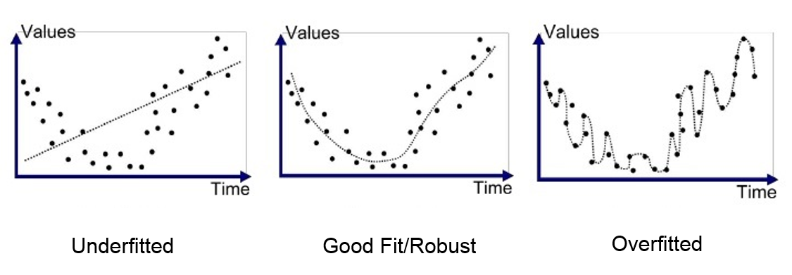
Some Problems with R-squared
Problem 1: Every time you add a predictor to a model, the R-squared always increases, even if due to chance alone.
Problem 2: If a model has too many predictors it begins to model the random noise in the data. This condition is known as overfitting the model.

Slide 11
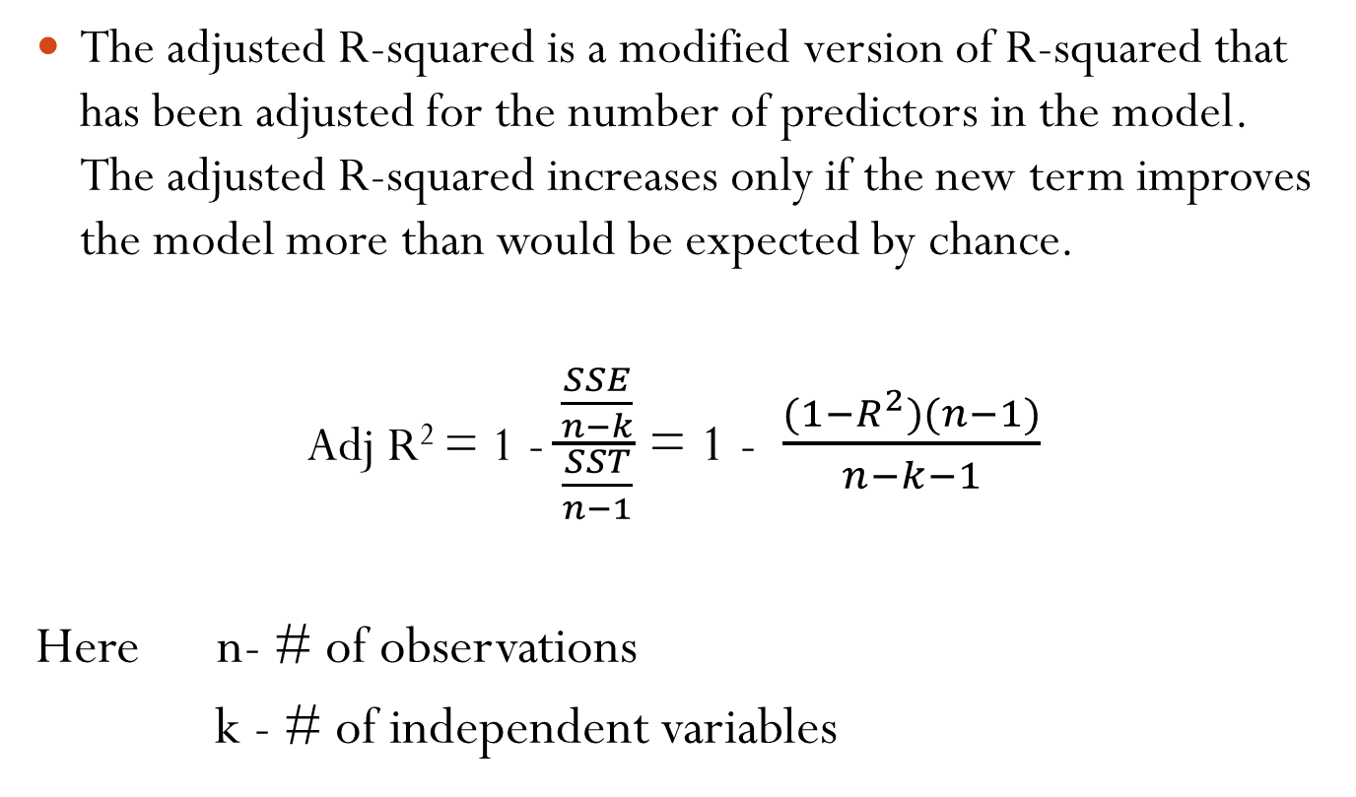
Adjusted R-squared
The adjusted R-squared is a modified version of R-squared that has been adjusted for the number of predictors in the model. The adjusted R-squared increases only if the new term improves the model more than would be expected by chance.
Adj R² = 1 - $\frac{\frac{SSE}{n−k}}{\frac{SST}{n−1}}$ = 1 - $\frac{(1−R^{2})(n−1)}{n−k−1}$
Here n- # of observations
k - # of independent variables

Slide 12
Categorical Data as Independent variables
Categorical independent variables can be incorporated into a regression model by converting them into 0/1 (“dummy”) variables
For binary variables, code dummies “0” for “no” and 1 for “yes”
For categorical variables with k categorical levels, use k–1 dummy variables.
Examples: Seasons of the year: 4-1 = 3 dummies
Months: 12-1 = 11 dummies
Gender: 2-1 = 1 dummy

Slide 13
Categorical Data as Independent variables
Ex. SMOKER has three levels:
non-smoker
former smoker
current smoker
Use k – 1 = 3 – 1 = 2 dummy variables to code this information like this:
SMOKER
Non-smoker
Former smoker
Current smoker
Former Smoker | Current Smoker
0 | 0
1 | 0
0 | 1

Slide 14
Example
The following data provides wage information for 15 construction workers. Here, wage is response variable, number of years of education and gender are predictor variables. Our task is to build multiple regression model.
Wage ($/hour) | Number of years of Education | Gender
15.25 | 16 | Male
14.65 | 14 | Male
6.25 | 14 | Male
17.55 | 12 | Female
11.25 | 12 | Female
21.25 | 13 | Male
25.65 | 17 | Female
7.50 | 12 | Male
17.25 | 14 | Female
13.35 | 16 | Male
13.45 | 16 | Male
14.84 | 15 | Male
18.29 | 17 | Male
19.58 | 12 | Female
24.50 | 14 | Female

Slide 15
Solution.
Initially, we have 2 independent variables: Number of years of education is numeric data (Let’s call it variable “Education”). Gender is categorical data. First, we need to turn this categorical data into dummy variable.
Gender can be converted into 1 dummy variable: Female
Gender
Female
Male
Female
1
0

Slide 16
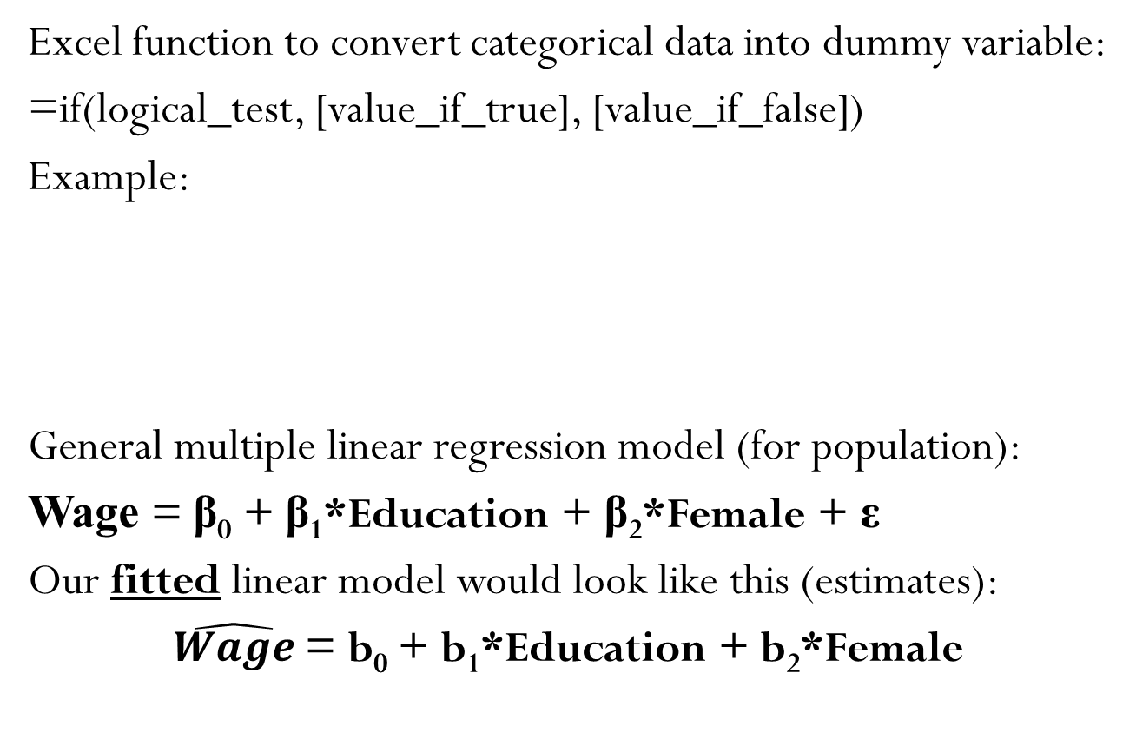
Solution.
Excel function to convert categorical data into dummy variable:
=if(logical_test, [value_if_true], [value_if_false])
Example:
General multiple linear regression model (for population):
Wage = β₀ + β₁*Education + β₂*Female + ε
Our fitted linear model would look like this (estimates):
$\hat{Wage}$ = b₀ + b₁*Education + b₂*Female
 | C | D | E
1 | Female | Formula | Gender
2 | 0 | =if(E2 = “Female”, 1, 0) | Male
3 | 1 | =if(E3 = “Female”, 1, 0) | Female

Slide 17
Solution.
Excel output from Data Analysis Regression:
ANOVA
 | df | SS | MS | F | Significance F
Regression | 2 | 189.514 | 94.757 | 4.890 | 0.028
Residual | 12 | 232.552 | 19.379
Total | 14 | 422.066
 | Coefficients | Standard Error | t Stat | P-value | Lower 95% | Upper 95%
Intercept | -7.205 | 10.258 | -0.702 | 0.496 | -29.556 | 15.146
Education | 1.426 | 0.687 | 2.076 | 0.060 | -0.071 | 2.923
Female | 7.249 | 2.481 | 2.922 | 0.013 | 1.844 | 12.654

Slide 18
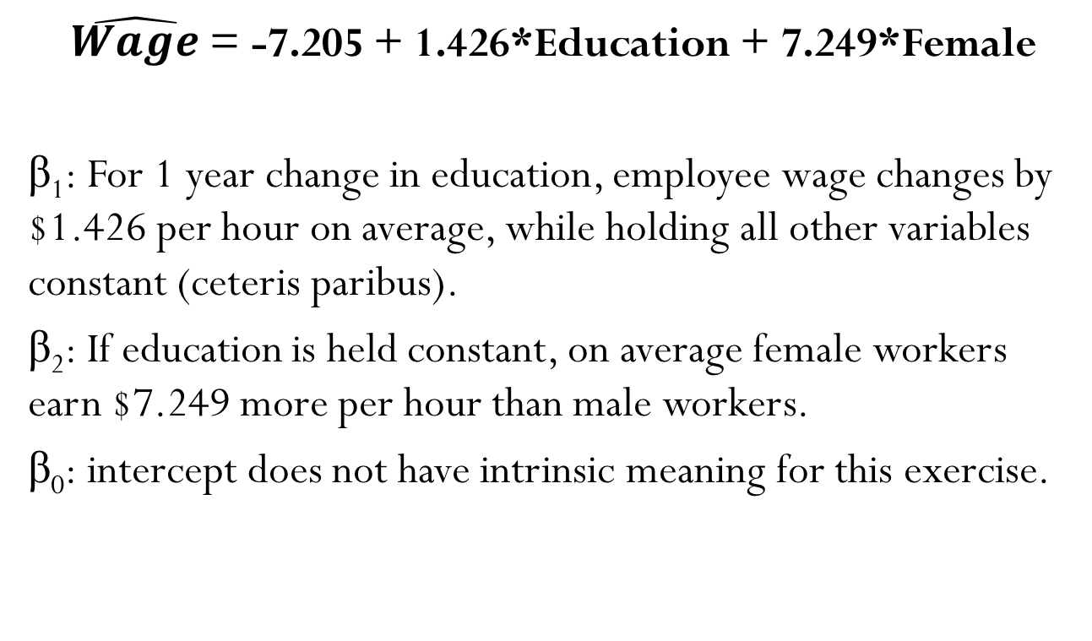
Fit Model and interpretations
$\hat{Wage}$ = -7.205 + 1.426*Education + 7.249*Female
β₁: For 1 year change in education, employee wage changes by $1.426 per hour on average, while holding all other variables constant (ceteris paribus).
β₂: If education is held constant, on average female workers earn $7.249 more per hour than male workers.
β₀: intercept does not have intrinsic meaning for this exercise.

Slide 19
Assumptions check
Normality. This assumption can be seen from Normal Probability Plot. If the plot follows straight line (or close enough) we can conclude that this assumption is not violated.
Linearity. Linearity can be assumed if scatterplots of dependent variable vs independent variable shows linear relationship (no need to check for dummies).

Slide 20
Assumptions check
No Multicollinearity. Correlation matrix will show how strong the relationship is between independent variables. We prefer the ones which have weak relationships.
Homoscedasticity. It can be seen from Residual plots. This example shows unequal variance (heteroscedasticity). Red arrows show how the variance is decreasing along the x axis.

